Slide 1
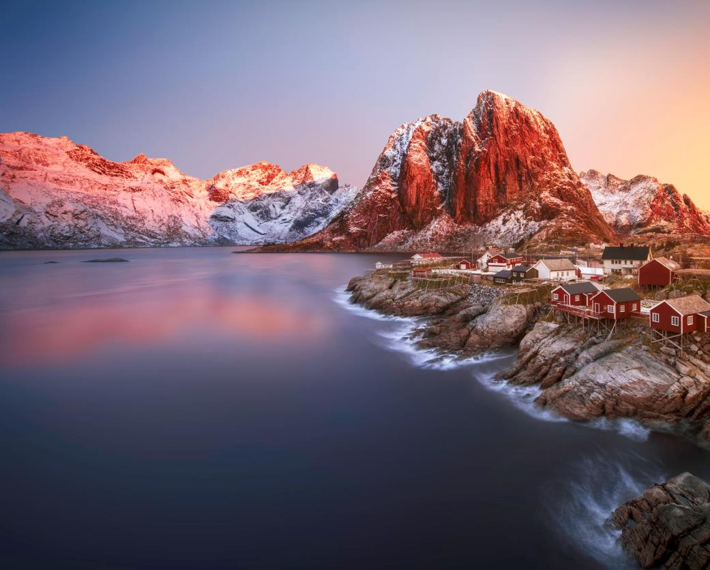

Limitless possibilities
&
Ultra Photographic Papers
Imperial Plus Coated Matt

Slide 2
The series is designed to inspire customers especially with the variety of products and surfaces available.
We believe that a great variety of easy-to-use products with different surfaces, grammages, white tones, etc. will inspire customers to express their individuality in their homes, workplace or elsewhere
Perfect print results by virtue of the photo-quality raw-base paper and the excellent colour receiver layers
Widest variety of products with different surfaces.
Outstanding lay-flat performance
High quality and consistent output
Excellent ageing resistance: Imperial Plus Coated Matt papers meet the requirements for ISO 9706. The longevity of the Ultra papers are assured through their resin coating. All papers enjoy a high light fastness through the addition of less optical brighteners in the raw-base paper.
Why
Why does this segment exist?
What is our purpose?
Imperial Plus Coated Matt; 10 SKUs with different grammage from 90-230 g/m²
Ultra Photographic Papers; 13 SKUs with diffrent finishes and grammages from gloss and satin and 190-270 g/m²
Poster series
How
How do we deliver the purpose?
What
What do we do to deliver the purpose?

Slide 3
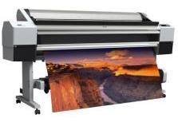
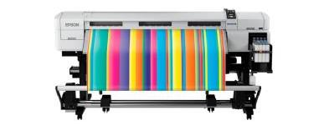
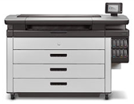
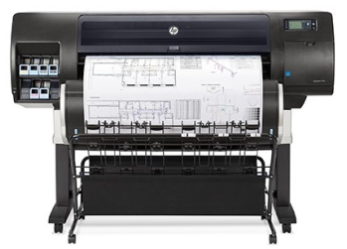
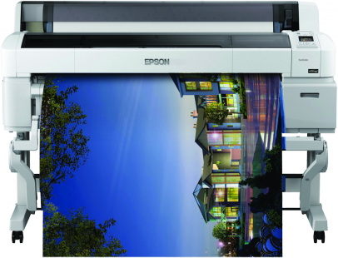
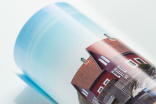
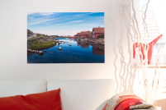

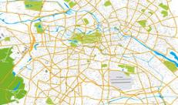
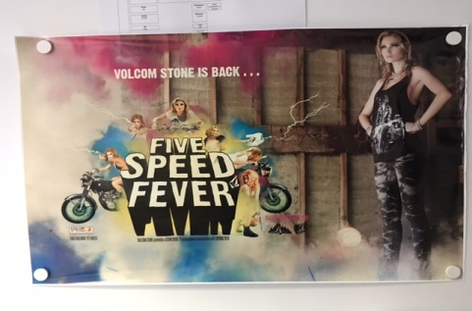
The products of the poster series are mainly used for posters and large-format photo prints.
Applications
Printing systems and manufacturers (examples)
Epson Stylus Pro 11880
Epson SureColor
HP PageWide XL
HP Designjet T7200
Epson SureColor SC T 7200
Application examples
Posters
Large-format photo prints
CAD
Maps
POS

Slide 4
The different papers offer a great variety of different surfaces,
Imperial Plus Coated Matt from 90 to 230g/m² &
Ultra Photographic Papers from 190 to 270g/m².
Product | Surface | Grammage | Product Category | Whiteness | Inkjet Printing
Imperial Plus Coated | Matt | 90 g/m² | Special-Coated Matt Paper | Bright White | Water-based
Imperial Plus Coated | Matt | 120 g/m² | Special-Coated Matt Paper | Bright White | Water-based
Imperial Plus Coated | Matt | 170 g/m² | Special-Coated Matt Paper | Bright White | Water-based
Imperial Plus Coated | Matt | 230 g/m² | Special-Coated Matt Paper | Bright White | Water-based
Ultra Photographic Paper | Glossy | 190 g/m² | Microporous Resin-Coated Paper | Natural White | Water-based
Ultra Photographic Paper | Satin | 190 g/m² | Microporous Resin-Coated Paper | Natural White | Water-based
Ultra Photographic Paper | PSO Satin | 260 g/m² | Microporous Resin-Coated Paper | Alpine White | Water-based
Ultra Photographic Paper | Glossy | 270 g/m² | Microporous Coated Paper | Alpine White | Water-based

Slide 5
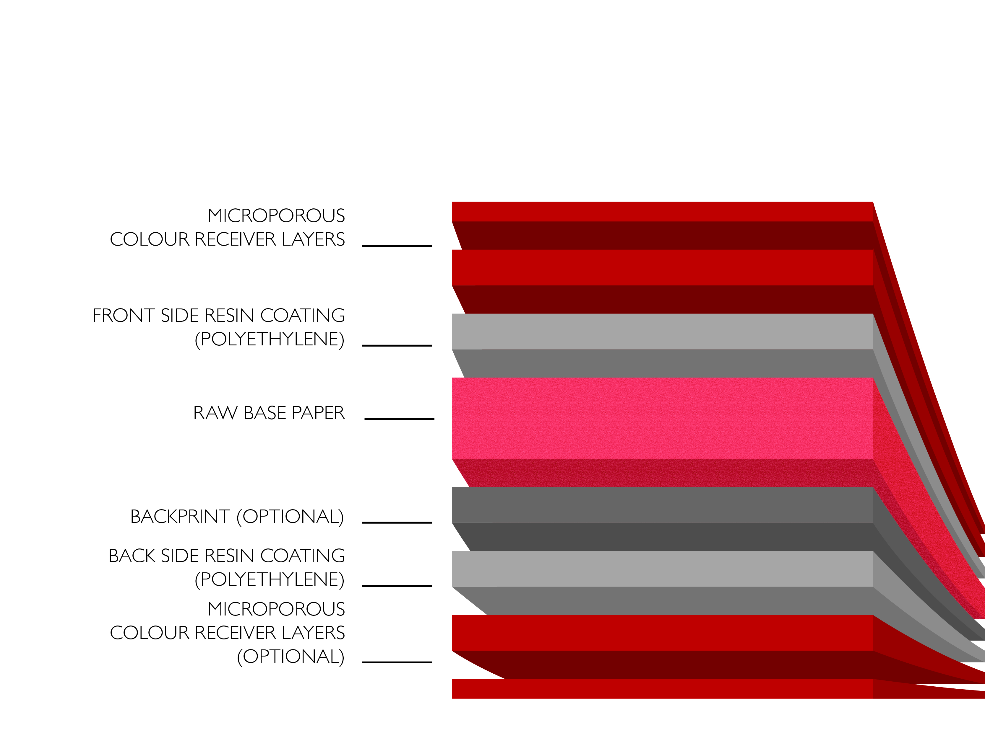
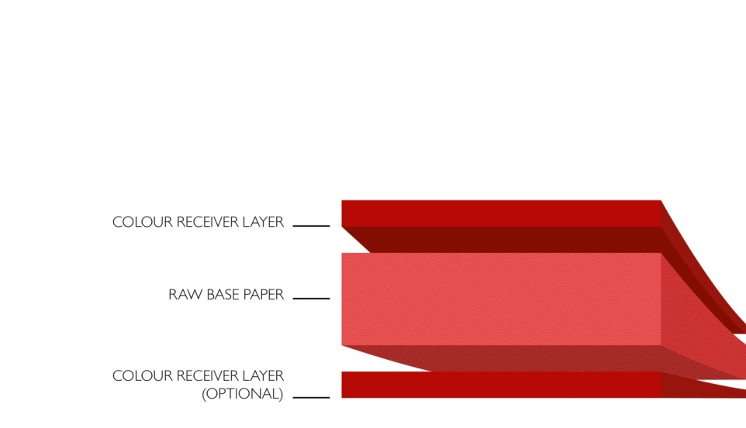
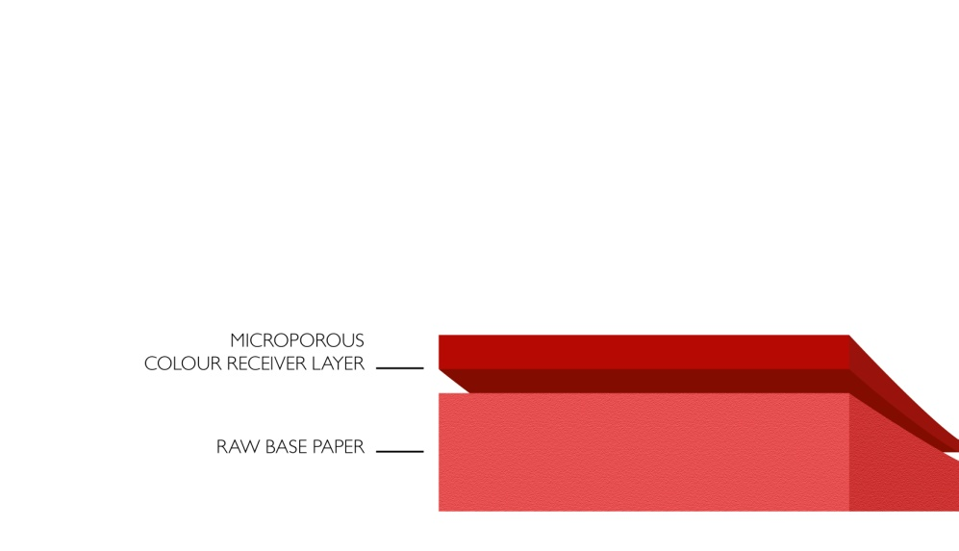
The product range offers different series with different product structures and Imperial Plus Coated Matt & Ultra Photographic Papers are printable with water-based inks.
Imperial Plus Coated Matt
Ultra Photographic Paper
Ultra Photographic Paper
Special-Coated Matt Paper
Grammages: 90 - 230 g/m²
Surfaces: Matt
Microporous Coated Paper
Grammages: 190 - 270 g/m2
Surface: Satin
Microporous Resin-Coated Paper
Grammage: 190 g/m2
Surfaces: Glossy

Slide 6








The products are inkjet water-based printable.
Printing technologies
Inkjet water-based
High-speed inkjet
systems
Inkjet solvent
Sublimation
water-based
Inkjet latex
Indigo systems
Inkjet UV
Dry toner systems

Slide 7
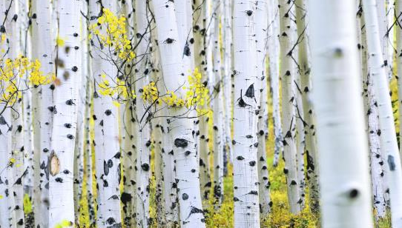


The Imperial Plus Coated Matt products show pin-sharp details and meet the criteria for permanence according ISO 9706.
Benefits & properties
Very smooth surface
Pin-sharp details
Vivid colours
High colour consistency and gamut
Meets criteria for permanence according ISO 9706
Product category & printing technology
Special-coated matt paper
Bright white; Matt surface
Range
Imperial Plus Coated Matt | Matt 90 g/m²
Imperial Plus Coated Matt | Matt 120 g/m²
Imperial Plus Coated Matt | Matt 170 g/m²
Imperial Plus Coated Matt | Matt 230 g/m²
Applications
Posters
Architectural drawings
Large-format photo prints
CAD
GIS (Maps)

Slide 8
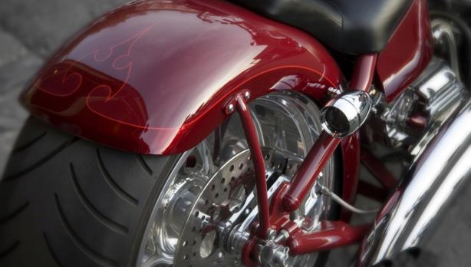
The Ultra Photographic Papers products are available with gloss and satin surfaces.
Benefits & properties
Pin-sharp details
Vivid colours
High colour consistency and gamut
High opacity
High light fastness
Water resistance
Outstanding lay-flat performance
Product category & printing technology
Microporous resin-coated paper
Alpine/Natural white; Glossy surface / Satin surface
Range
Ultra Photographic Papers | Gloss 190 g/m²
Ultra Photographic Papers | Satin 190 g/m²
Ultra Photographic Papers | PSO Satin 260 g/m²
Ultra Photographic Papers | Satin 270 g/m²
Applications
Photo cards
Art Reproductions
Photo prints
Portraits

Slide 9
Thanks for listening!
For more information please contact our Sales Team on:
1300 713 567
displayandvisual@ballanddoggett.com.au

